Slide 1
Agriculture production
HUL315
Submitted by:
Suresh(2016CE10215)
Vikram Kumar(2016CE10217)

Slide 2
Input:
High-Yielding Varieties (HYVs) of agricultural crops
Rainfall during cropping session
Irrigation intensity
Multiple-Cropping Index
Output: YIELD of kharif crop
Rice
Bajra
Maize
Jowar

Slide 3
$$YIELD= β_{0}+β_{1}HYV+β_{2}Rainfall1+β_{3}Rainfall2+β_{4}II+β_{5}MCI$$
S.No. | Variables | Descriptor | Mean | Std.
1 | HYV | HYVRICE | 17 | 44.9
 |  | HYVBAJRA | 6.37 | 16.53
 |  | HYVJOWAR | 2.88 | 8.91
 |  | HYVMAIZE | 1.43 | 2.89
2 | Rainfall1 | Rainfall(Jul.+Aug.,Sept.) | 797.47 | 369.67
3 | Rainfall2 | Rainfall(Oct.+Nov.+Dec.) | 109.5 | 96.42
4 | II | Irrigation Intensity | 0.24 | 0.21
5 | MCI | Multiple-cropping Index | 1.19 | 0.16

Slide 4
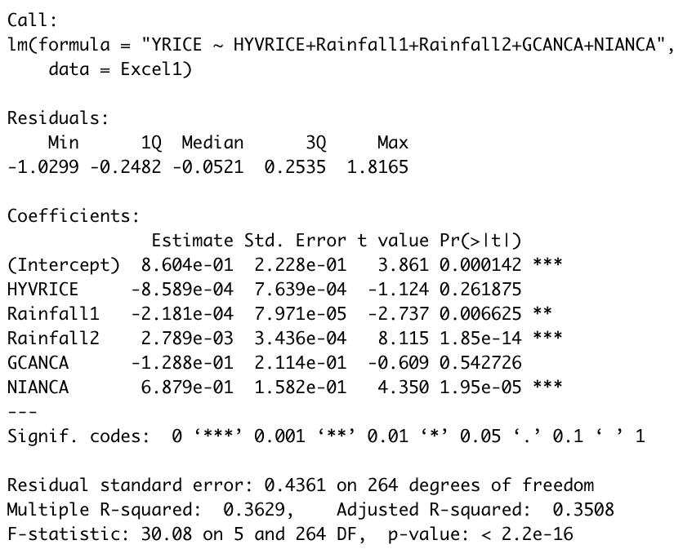
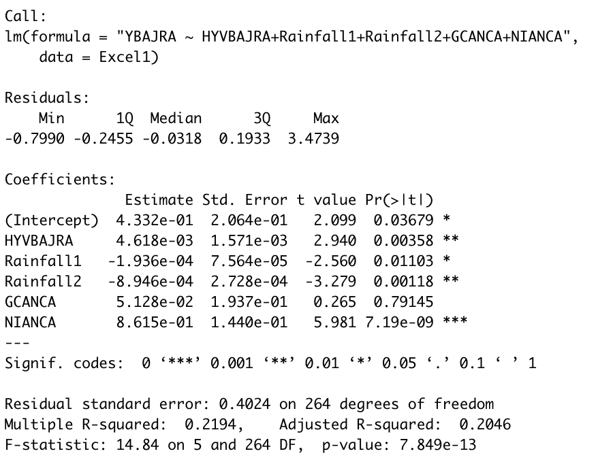
RICE:
BAJRA:

Slide 5
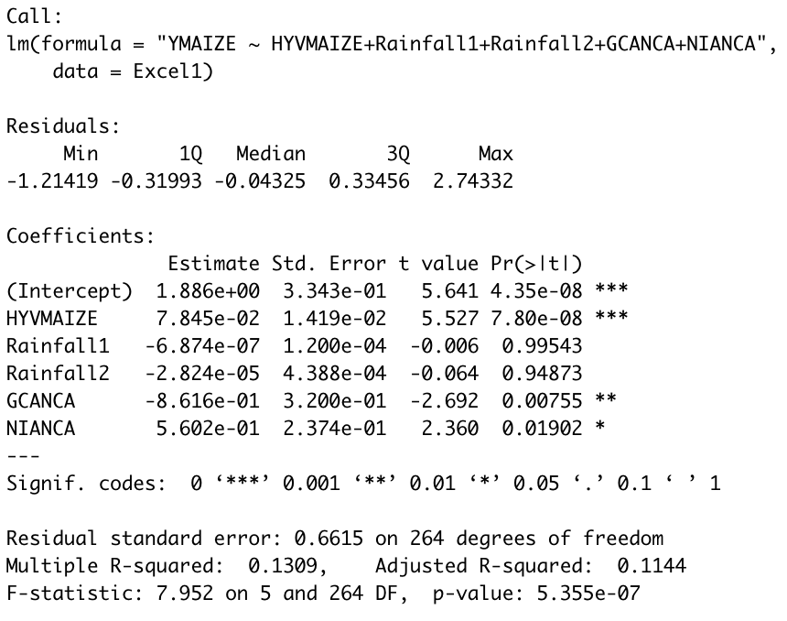
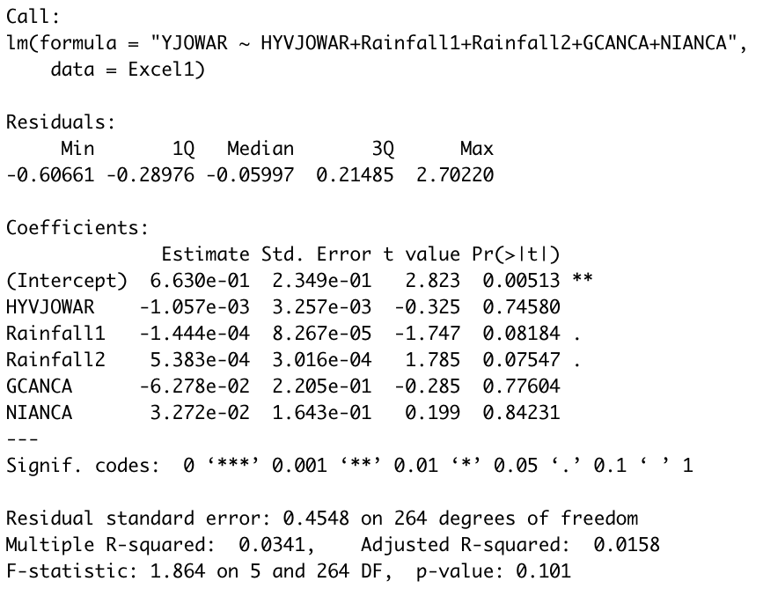
Maize:
Jowar:

Slide 6
Revise the model by adding extra descriptor
Price
Dummy variable for Aquifer depth(Ground water)
DMAQ1: dummy variable = 1 if aquifer is <100 meters thick
DMAQ2: dummy variable = 1 if aquifer is 100 - 150 meters thick
DMAQ3: dummy variable = 1 if aquifer is > 150 meters thick
QTRACTORHA=Number of Tractor per hectare
QBULLHA=Number of Bulls per hectare
QNITRO, QP₂O_{5,} QK₂O = Quantities of fertilizers (nitrogen, phosphorus and potassium) in tons

Slide 7
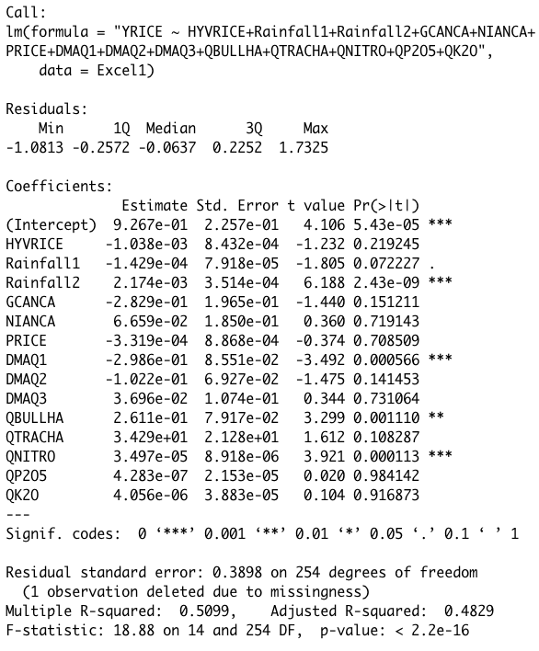
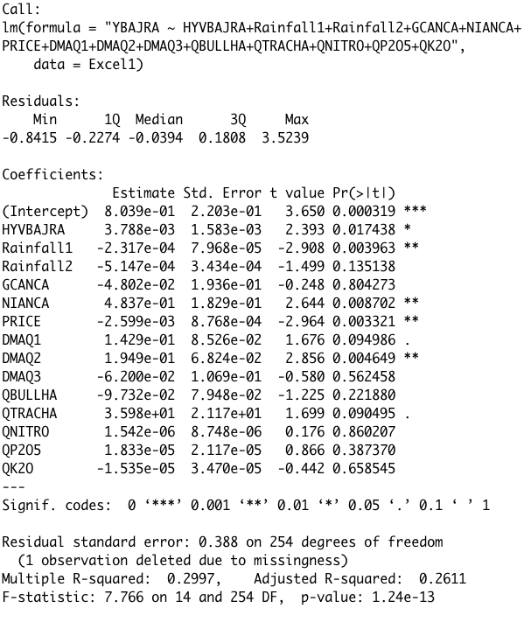
Revised model
RICE:
BAJRA:

Slide 8
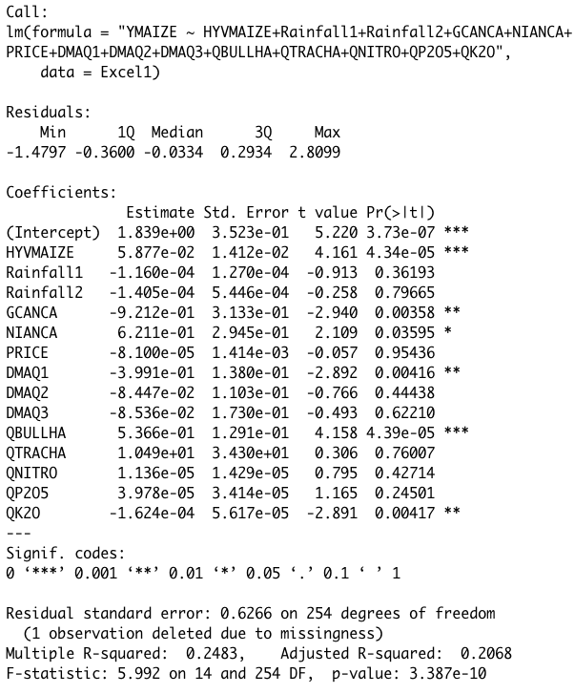
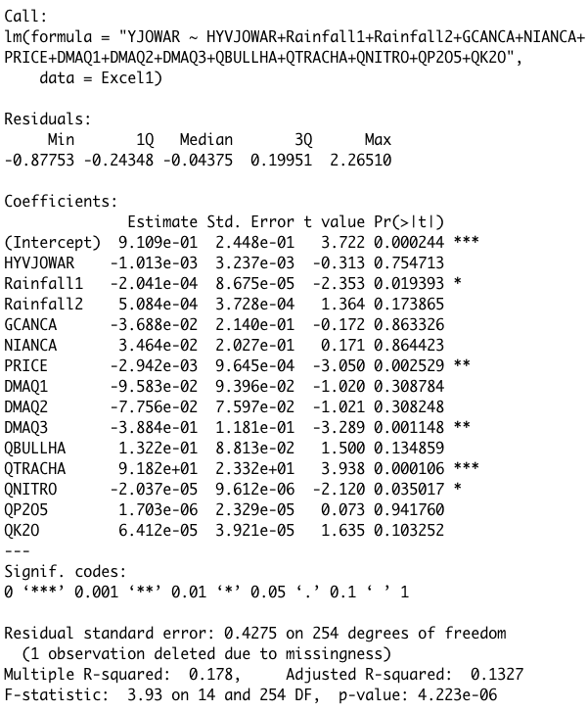
Revised model
Maize:
Jowar:

Slide 9
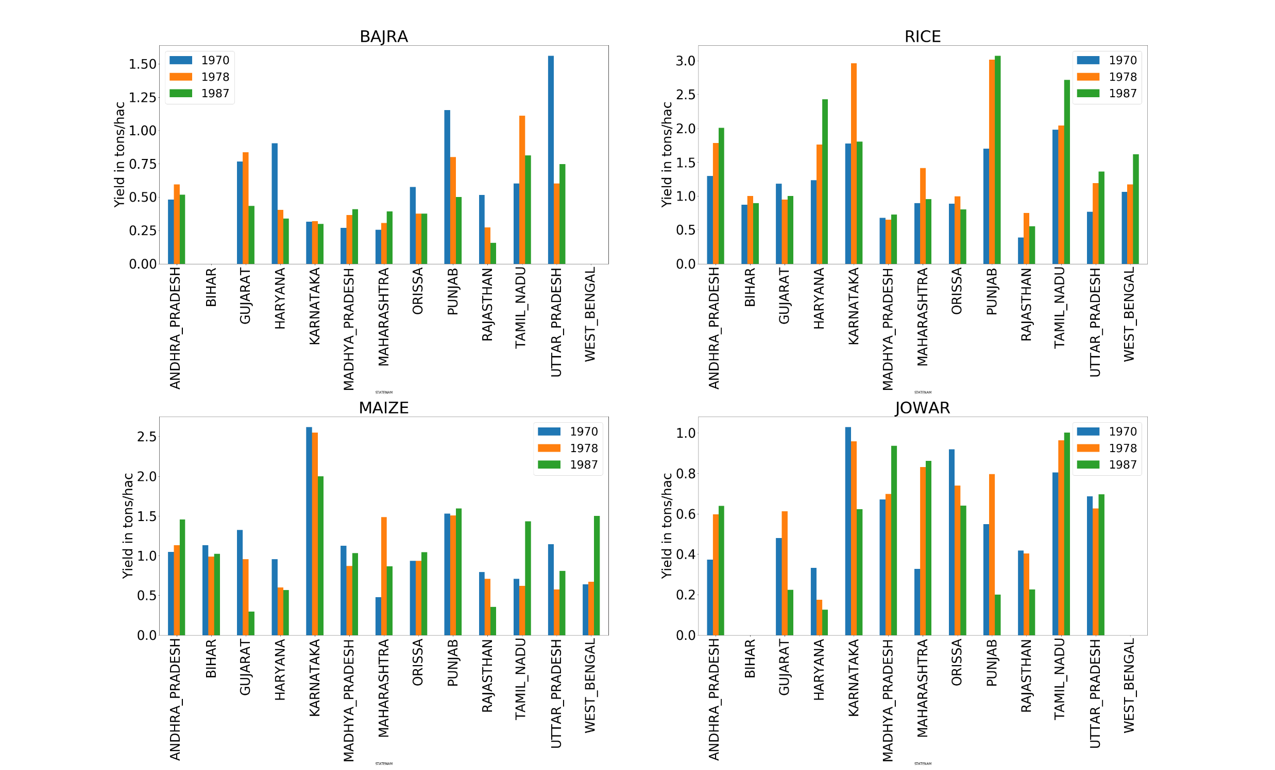
Yield for crop year wise

Slide 10
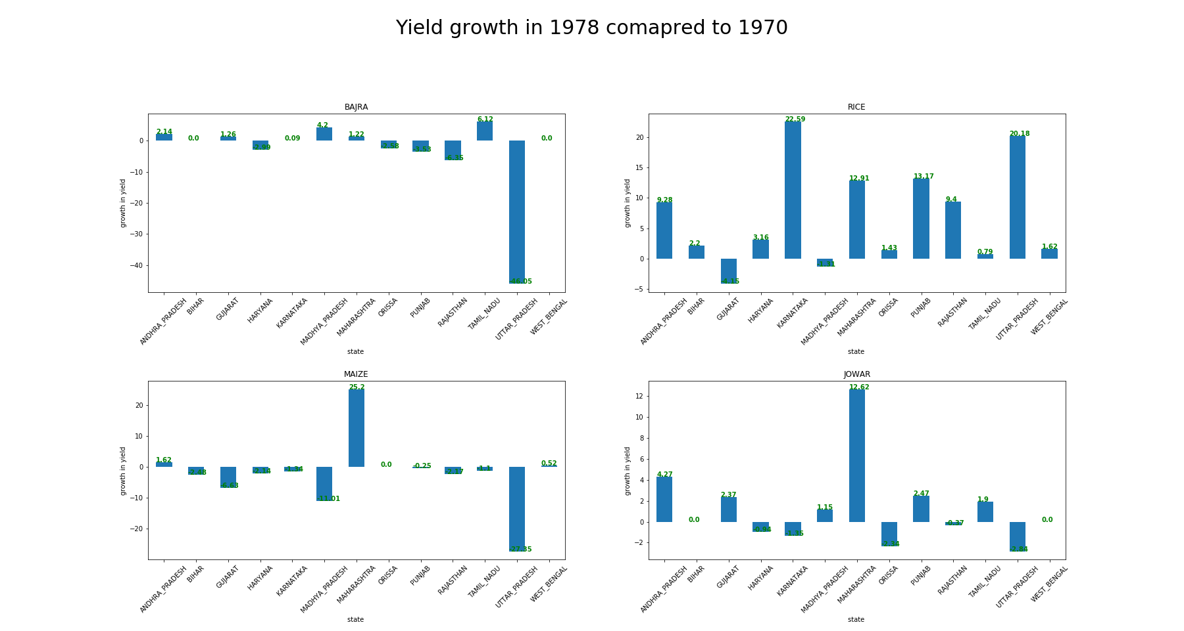

Slide 11
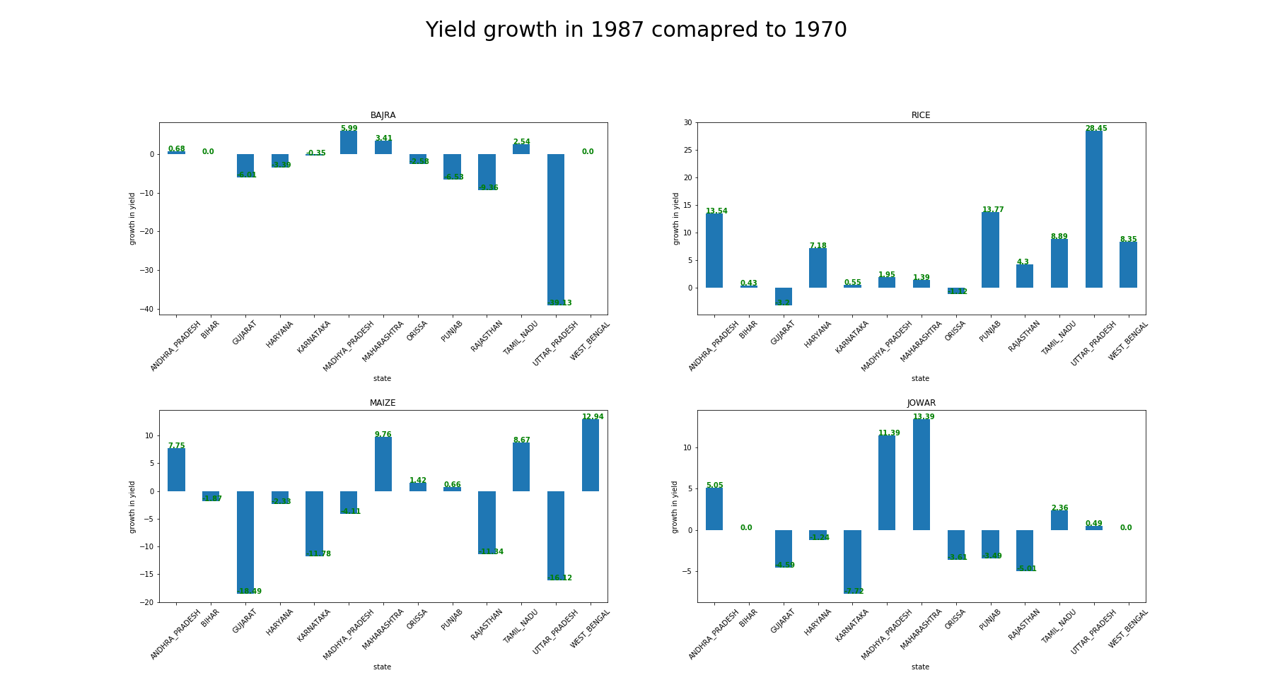

Slide 12
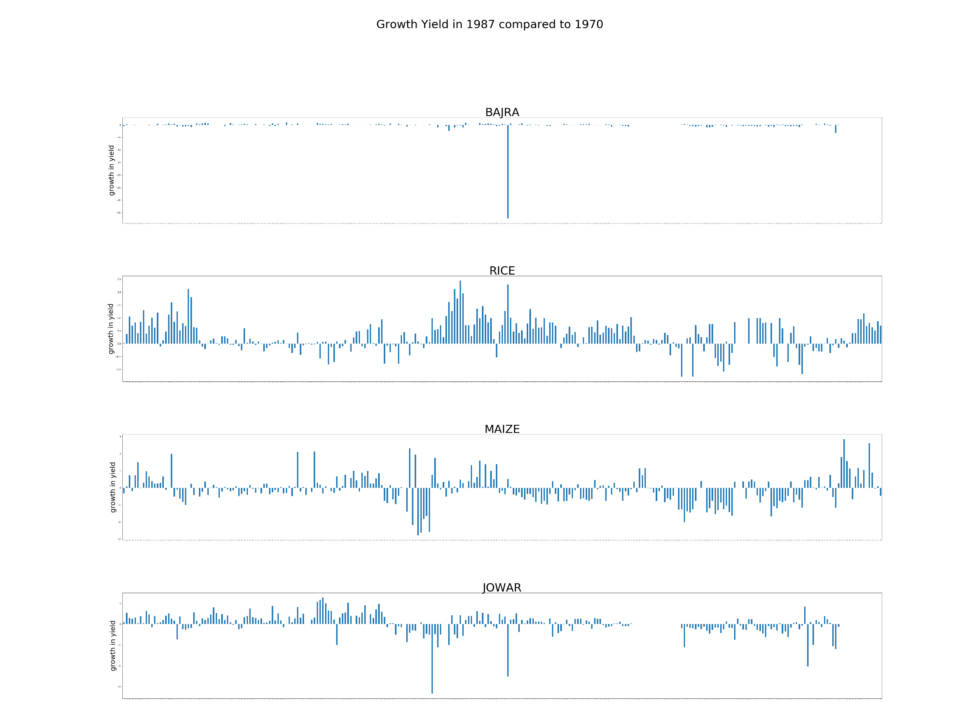

Slide 13
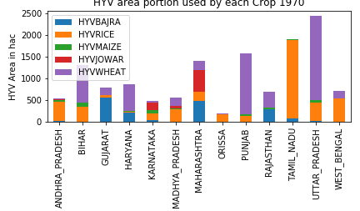
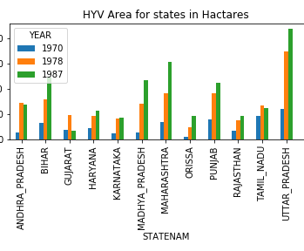
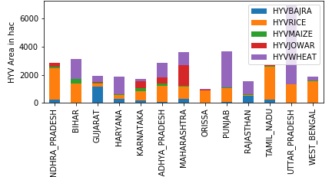
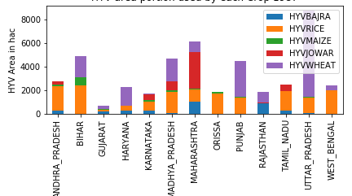

Slide 14
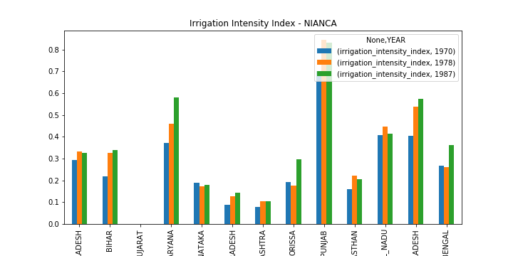
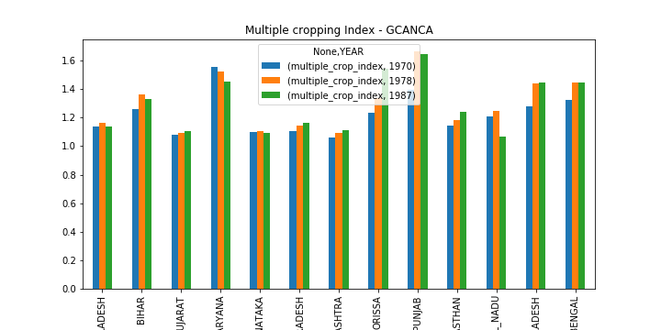

Slide 15
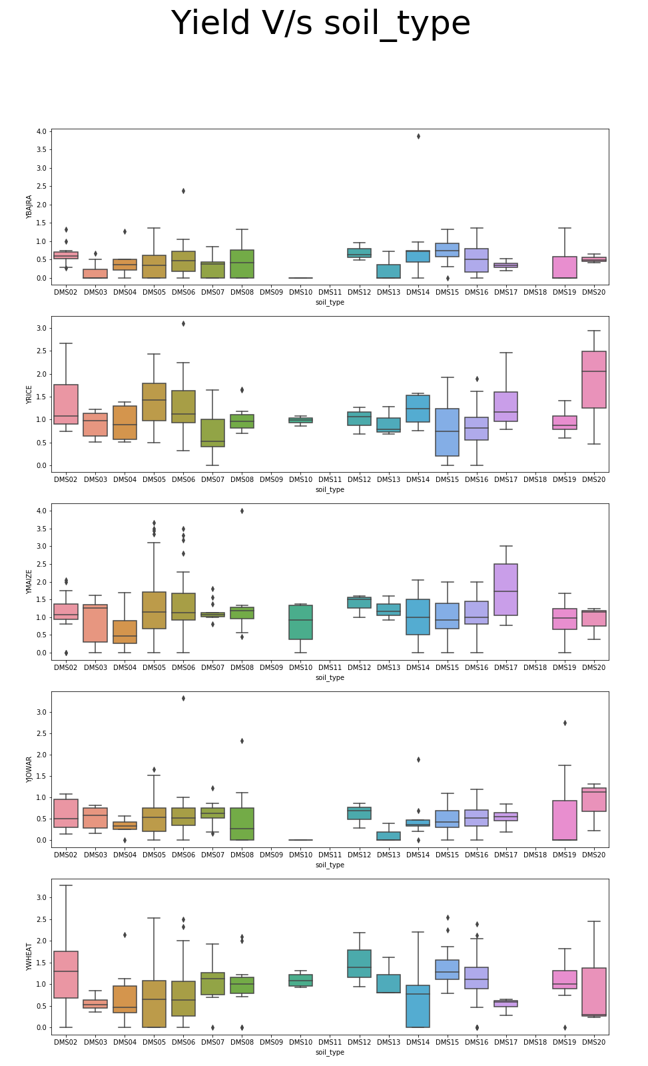
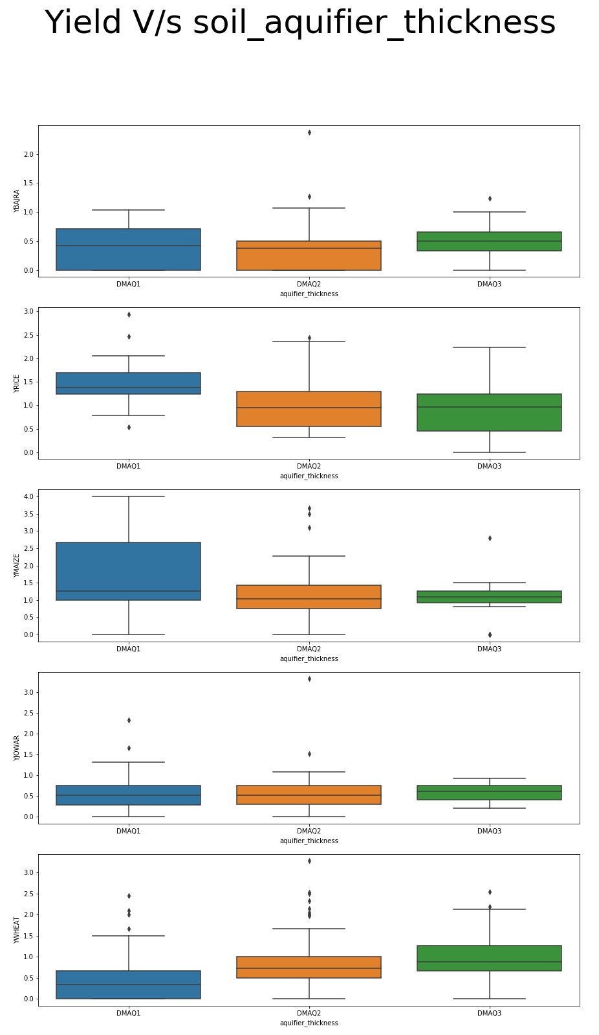
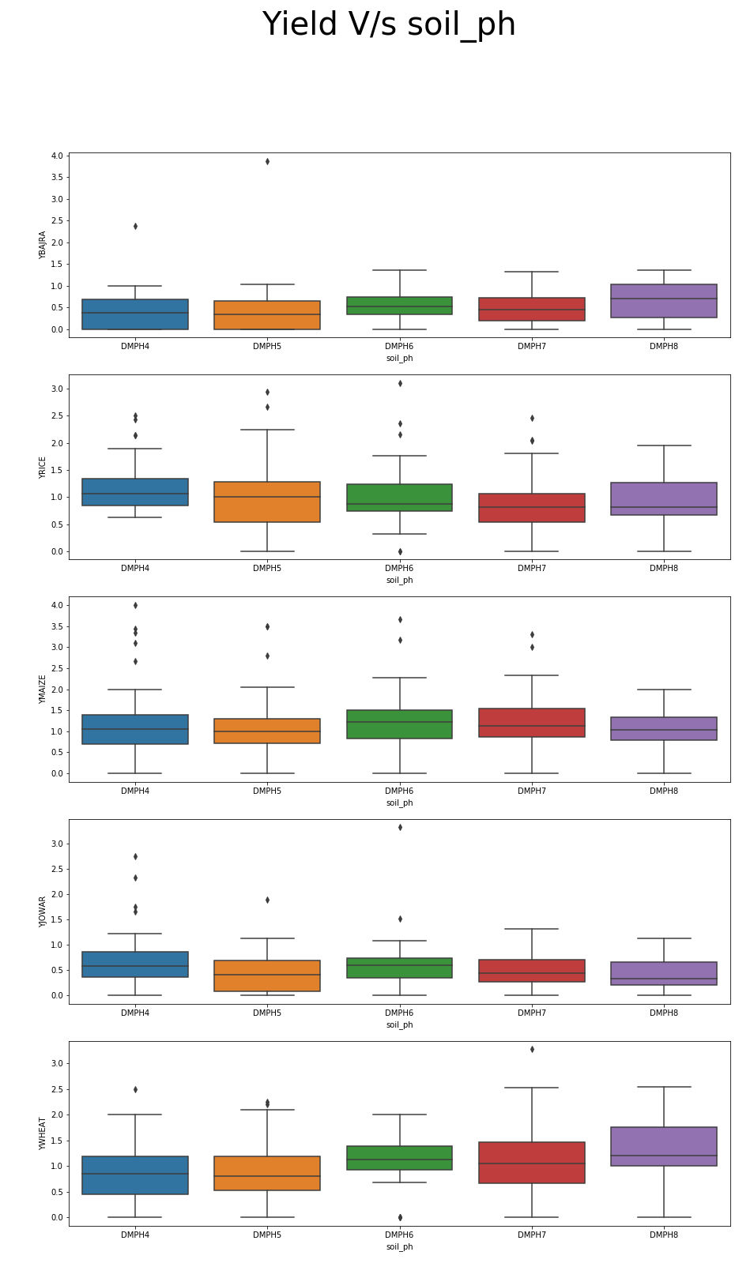

Slide 16
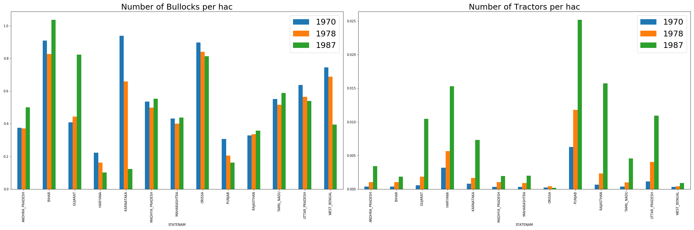

Slide 17
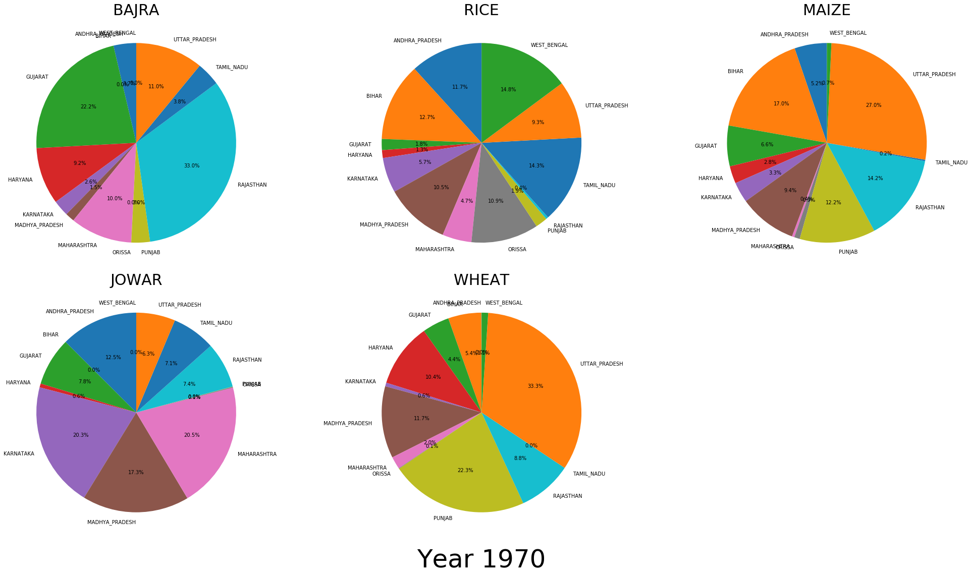

Slide 18
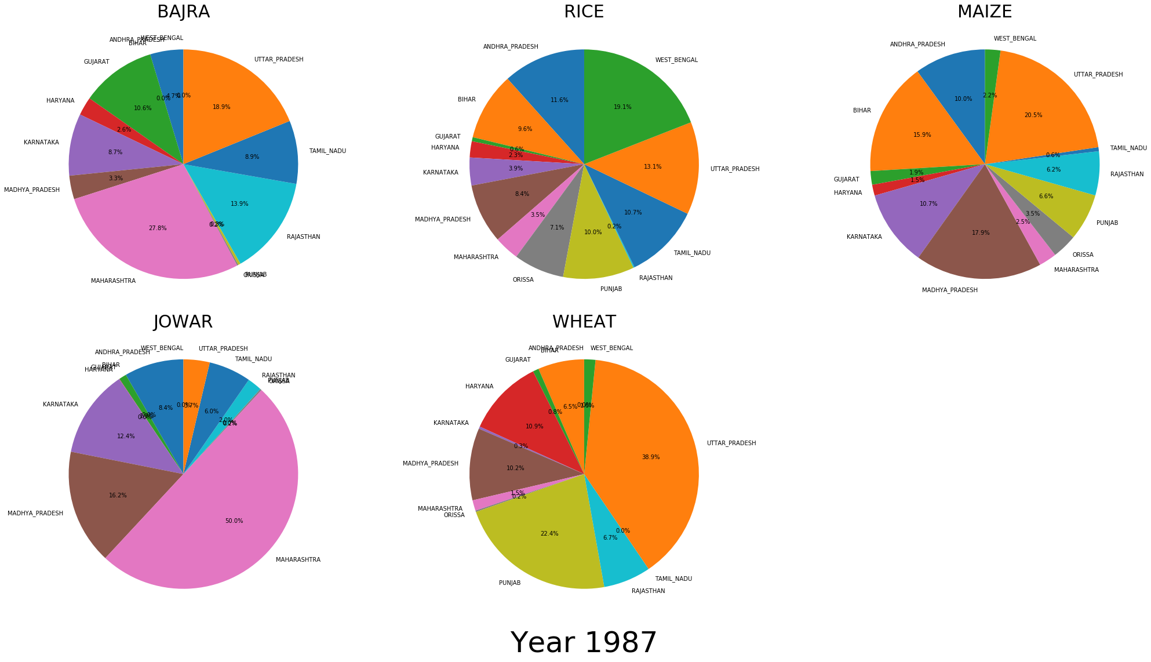

Slide 19
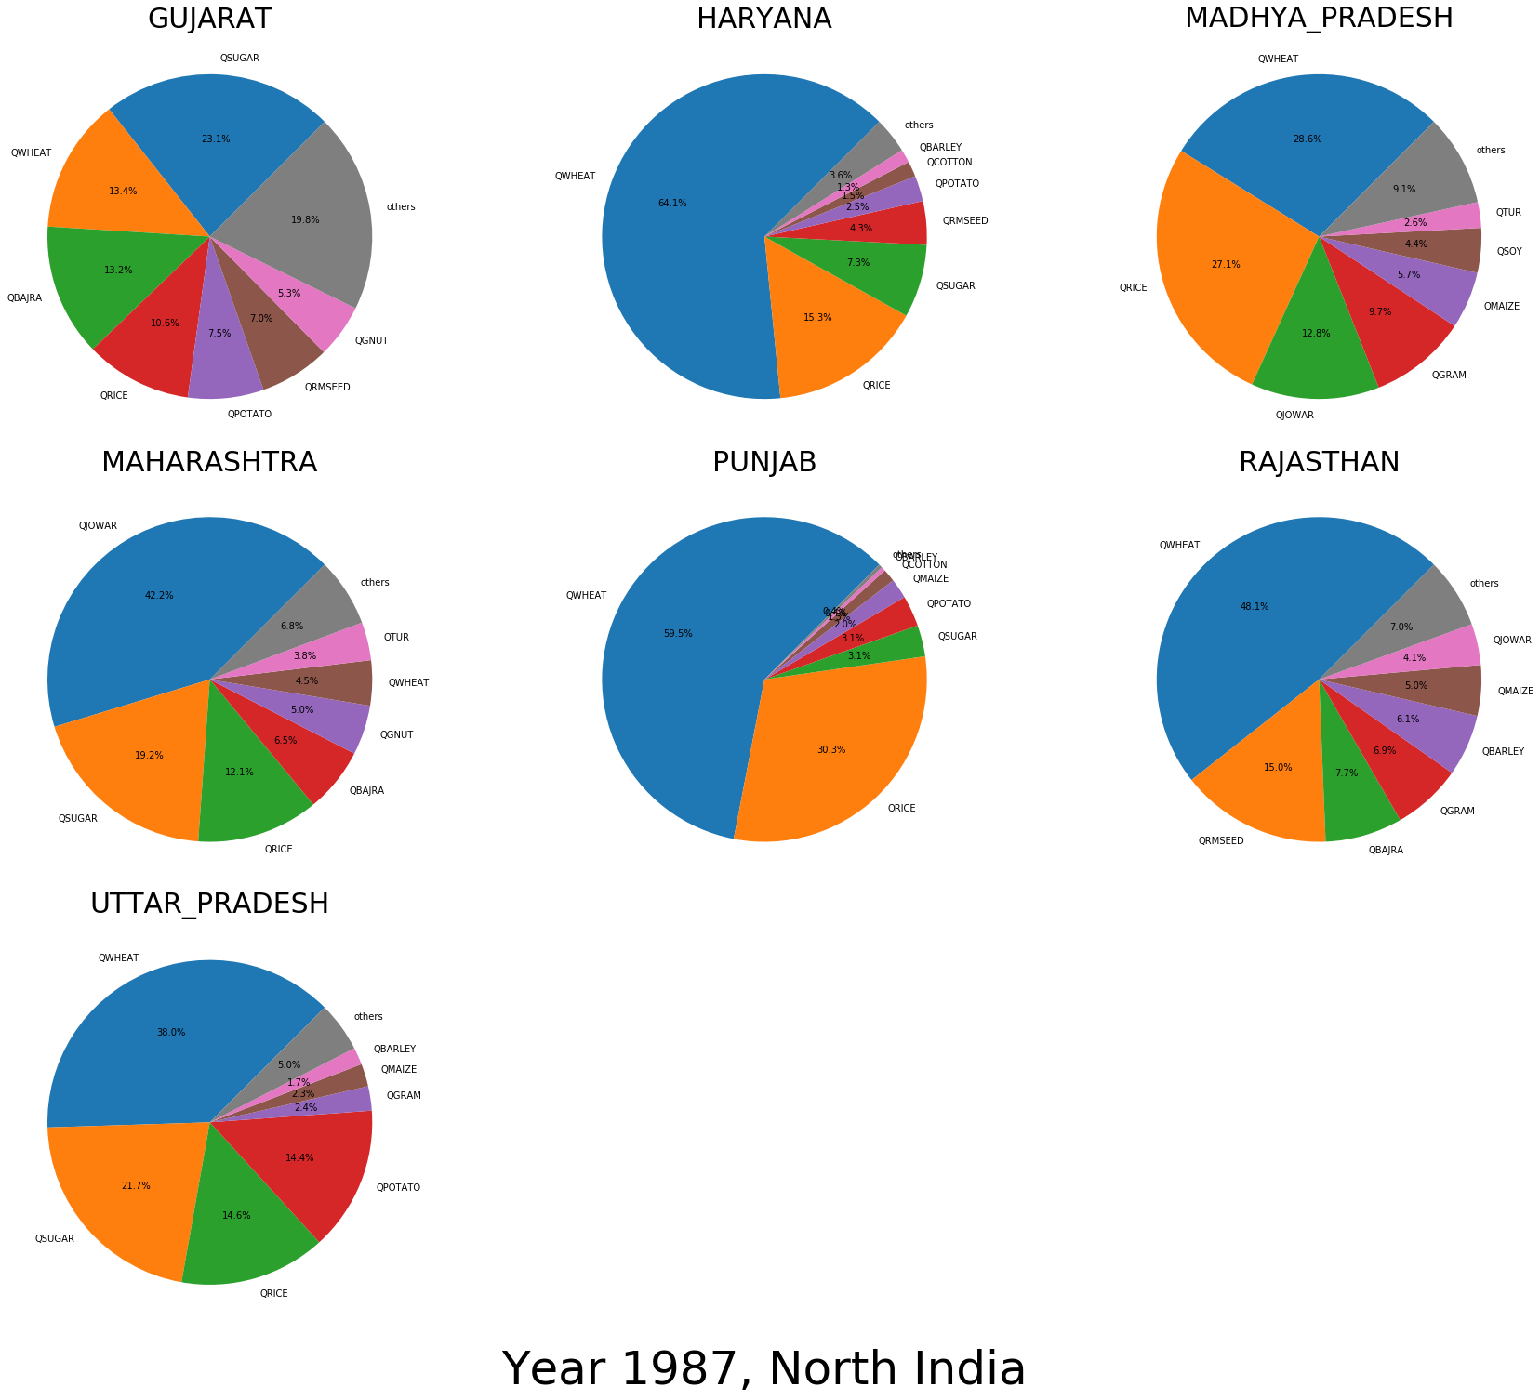

Slide 20
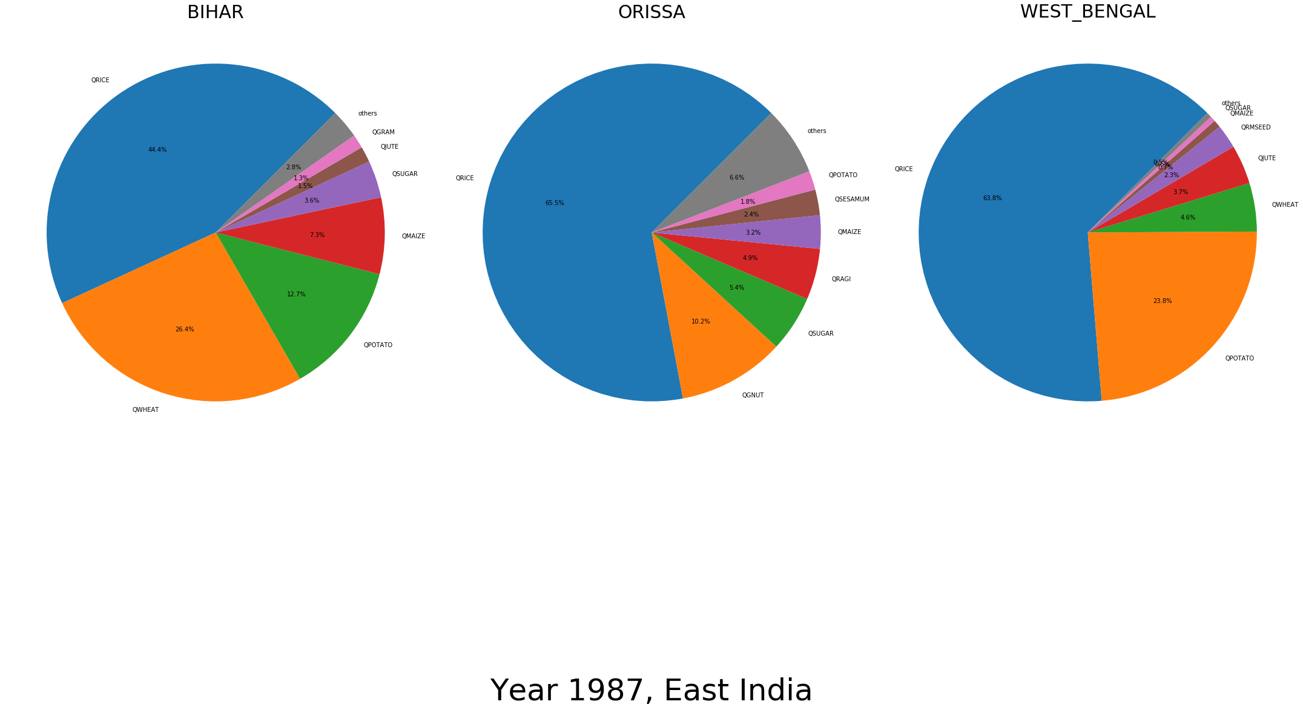

Slide 21
